Slide 1
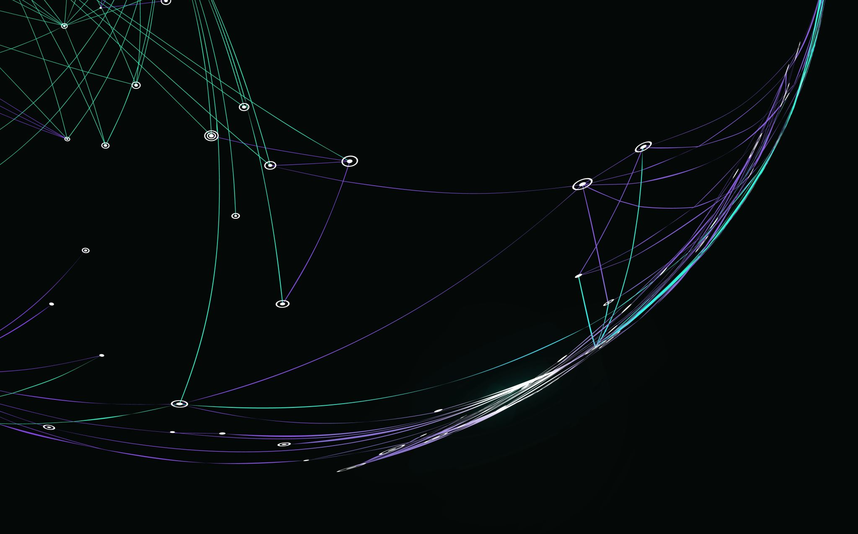
ITS350 Diffie-Hellman Showcase with a MITM Attack
By: Sebastian Merida
Notes:
The purpose of this presentation and the project itself is to showcase how the topics that we have learned in this class are applied to the real world. By showing both the target and the attacker and how both interact with one another to achieve overall acces or security prepares us better to counter-act and educate ourselves on persistent and common threats that we security analysts deal with day-to-day. To quote Christopher Hadganey the author of the Book Social Engineering: The Science of Human hacking: Social engineering is a tool like a hammer, shovel, knife, or even a gun. Each has a purpose that can be used to build, save, feed, or survive; each tool also can be used to maim, kill, destroy, and ruin. For you to understand how to use social engineering to build, feed, survive, or save, you need to understand both uses". Same can be applied to showcasing MITM attacks.

Slide 2
The Setup
Both the BOB and ALICE VMs will be running on a private virtual network connected to the host machine.
This significantly makes easier using a packet analyzer like Wireshark to track Bob and Alice messages (MITM).
Given software limitations with Vmware Fusion the Attacker is going to be hosted by BOB.

Slide 3
Diagram
Messenger
Receiver
BOB (VM-1)
172.16.xx.xxx
ALICE (VM-2)
172.16.xx.xxx
Attacker
Sebastian (VM-3)
172.16.xx.xxx

Slide 4
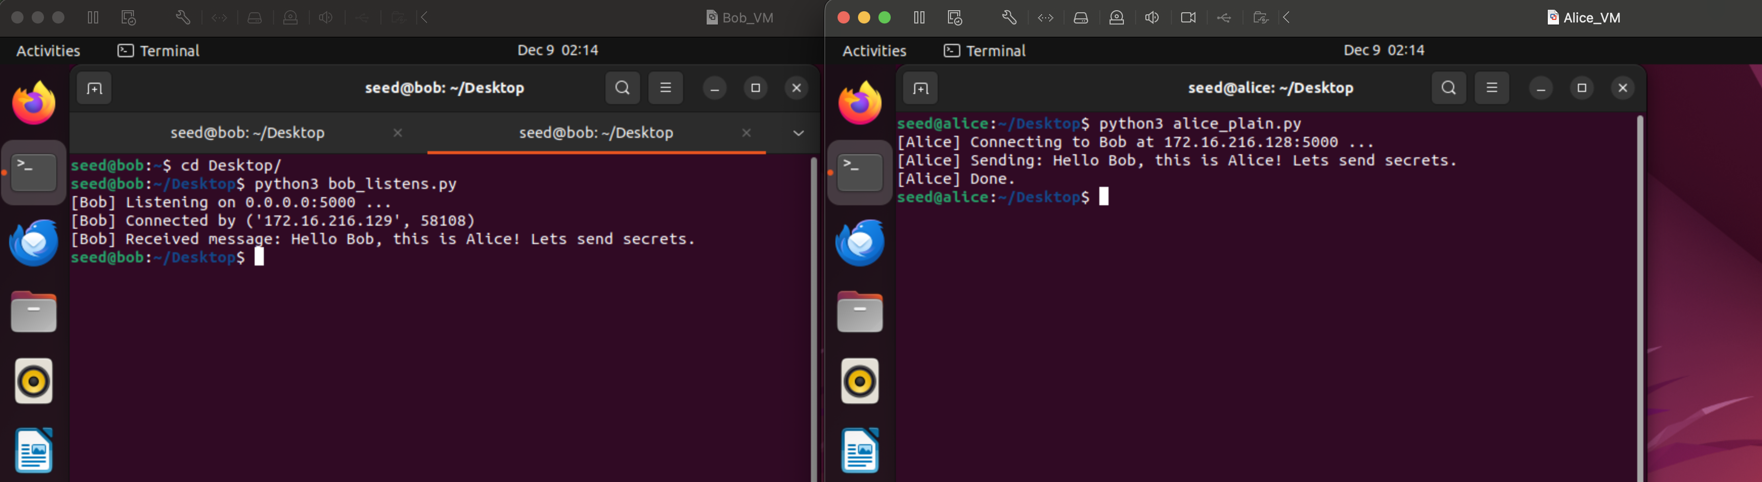
Step 1: Establishing a line of contact between Alice and Bob
Bob acts like a server, a small script meant to listen into a certain port and output received messages.

Slide 5
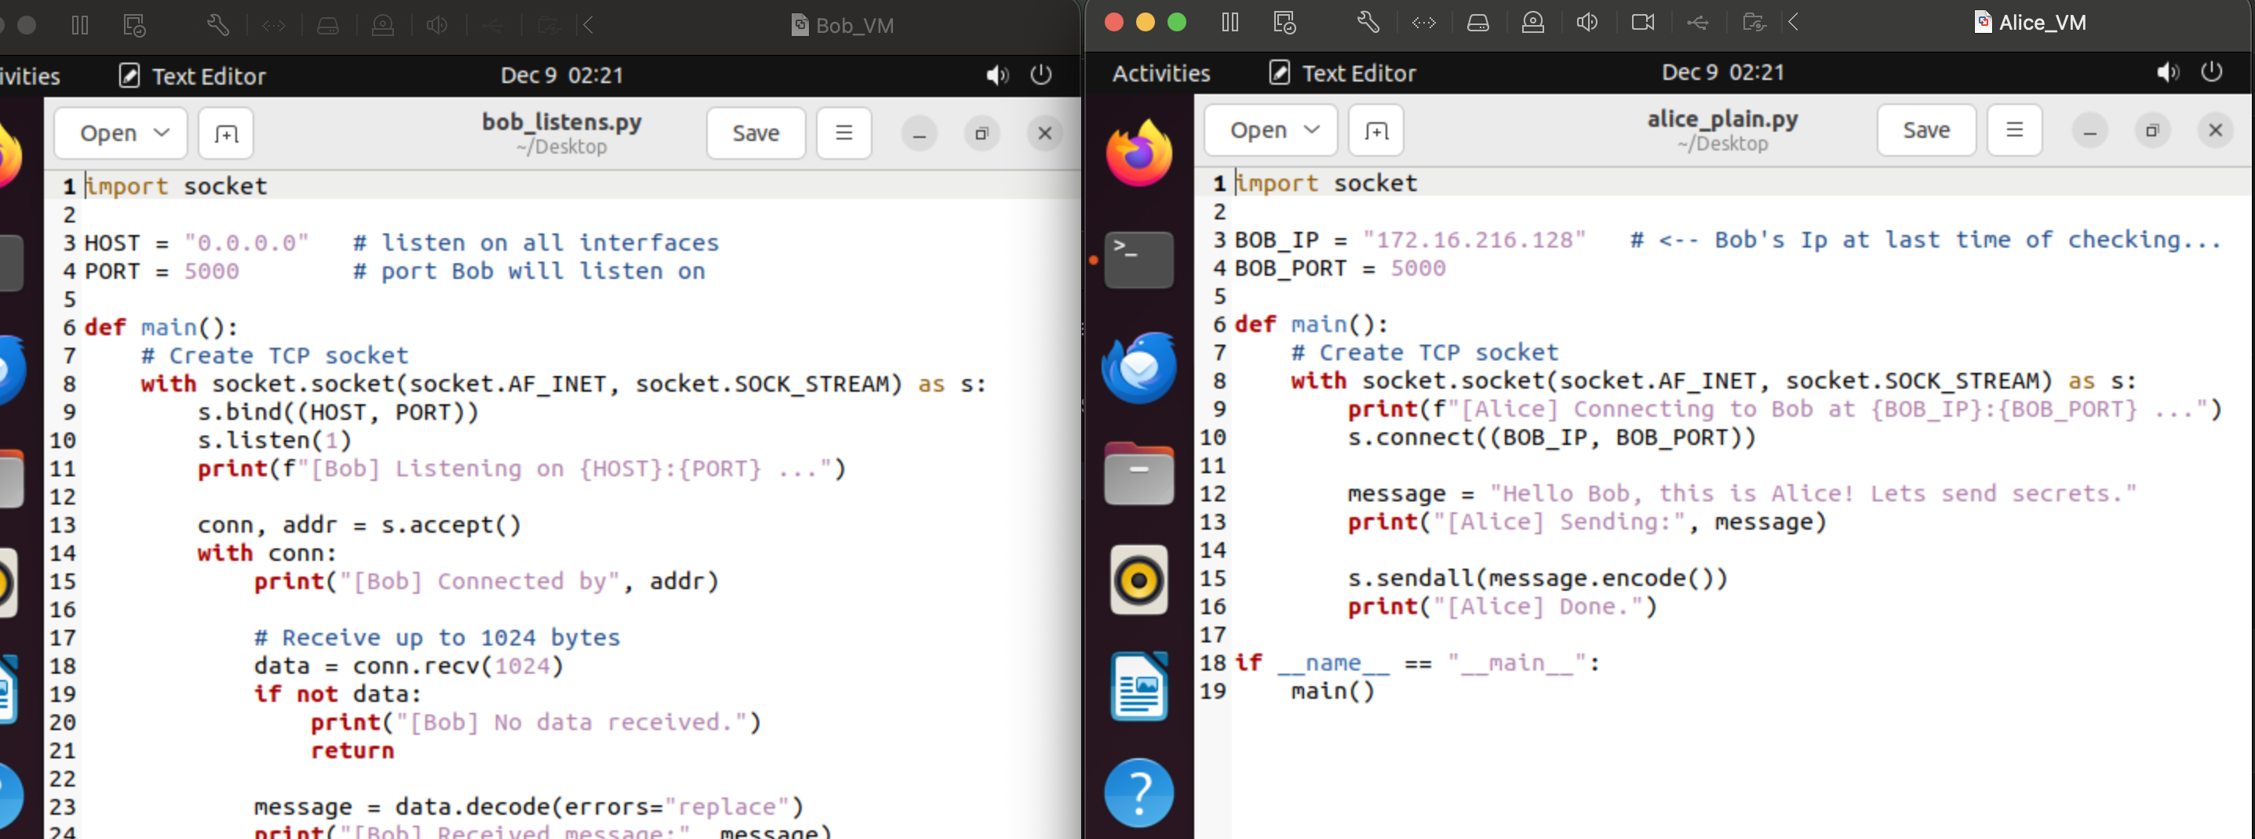
Scripts

Slide 6

Using Wireshark to capture packets
- Bob (Receiver) will be running Wireshark on the side to demonstrate how the packets and the message are affected affected throughout the project.

Slide 7
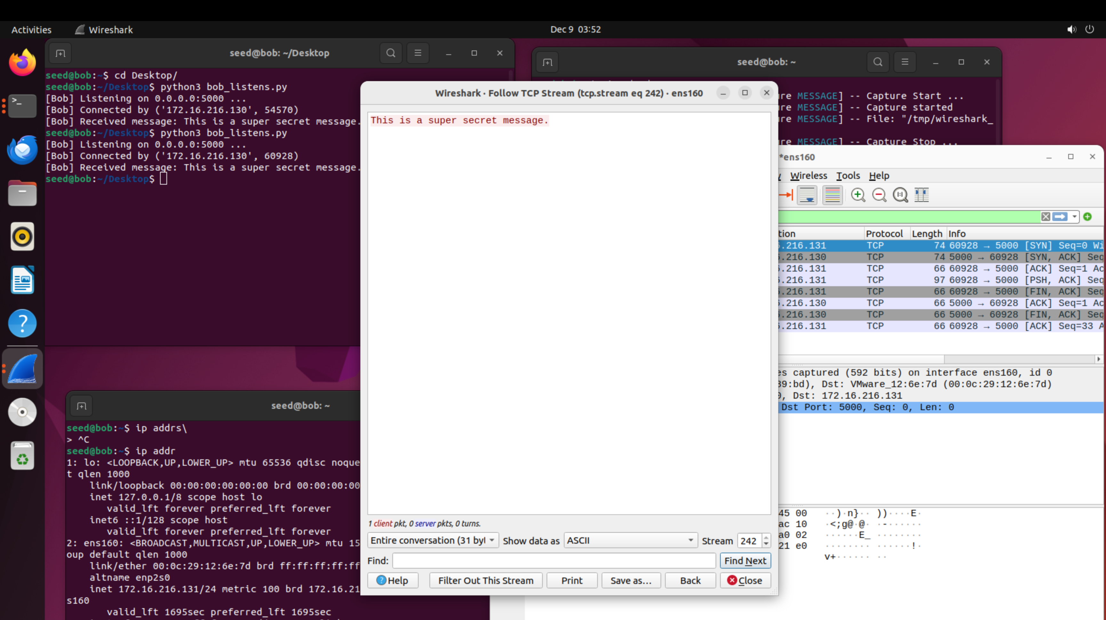
Wireshark Capture

Slide 8
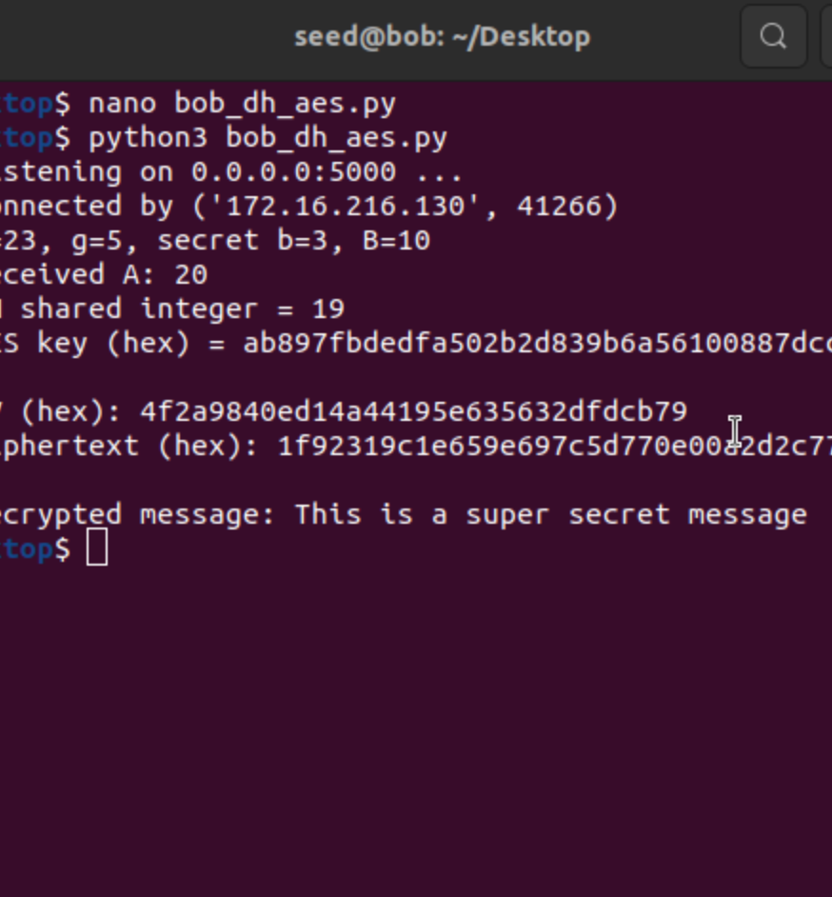
Step 2: Introducing DH and AES
We use small demo DH parameters (p = 23, g = 5) for testing purposes.
AES in CFB mode are used so we do not worry about padding.
Both Bob and Alice set-up AES key exchange servers…

Slide 9
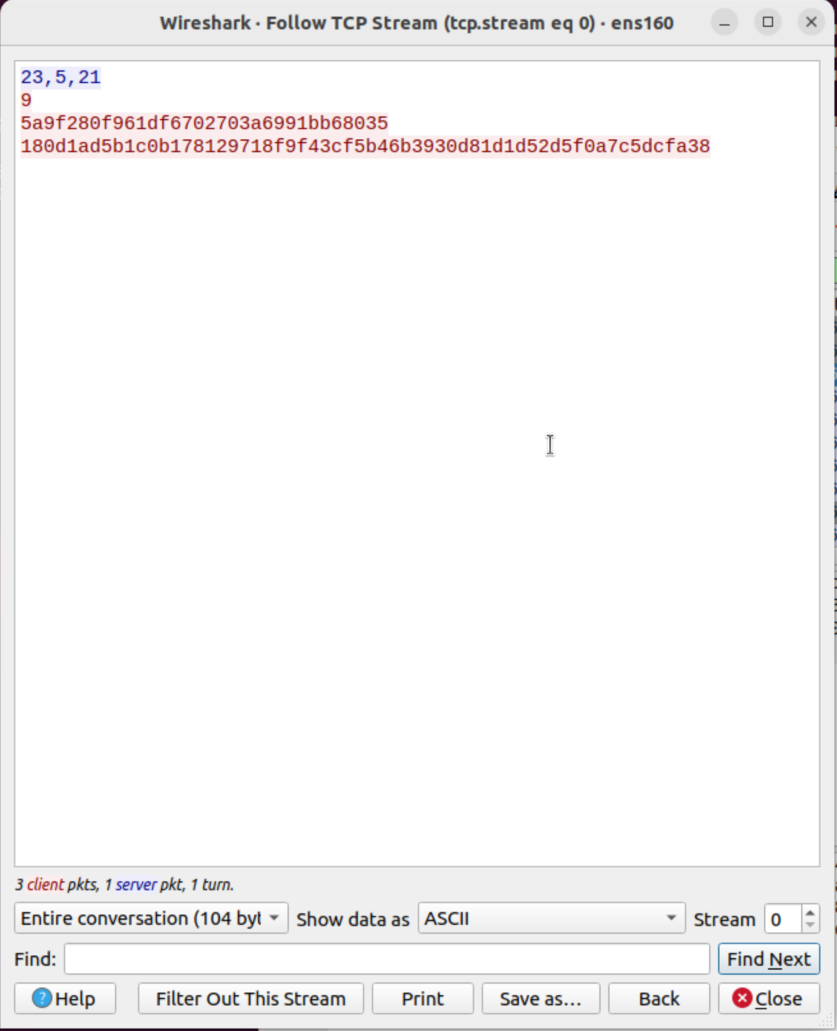
Wireshark Capture
Screenshot presented is the message captured being sent with AES.
We also can find the Values p, g, A, B, and the IV hex.
Given that said the private values are exposed during transmission it opens the door for exploitation from a malicious actor.

Slide 10
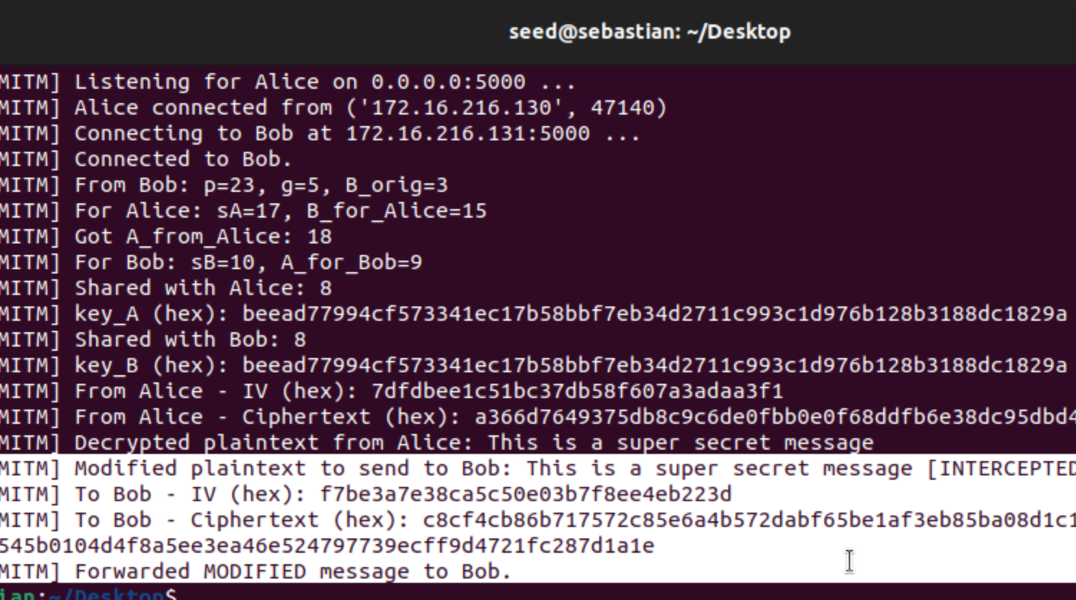
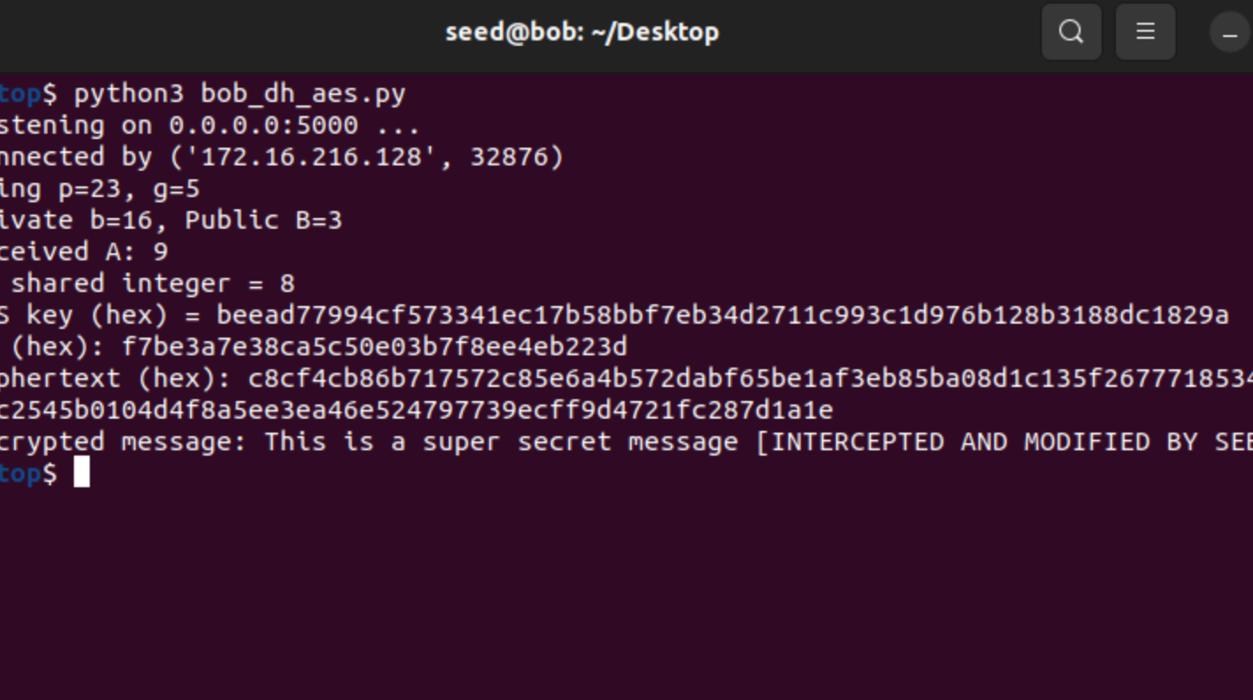
Step 3: MITM from Sebastian
- Alice is compromised and instead of listening directly to Bob all her outgoing connections go through Sebastian and then towards Bob

Slide 11
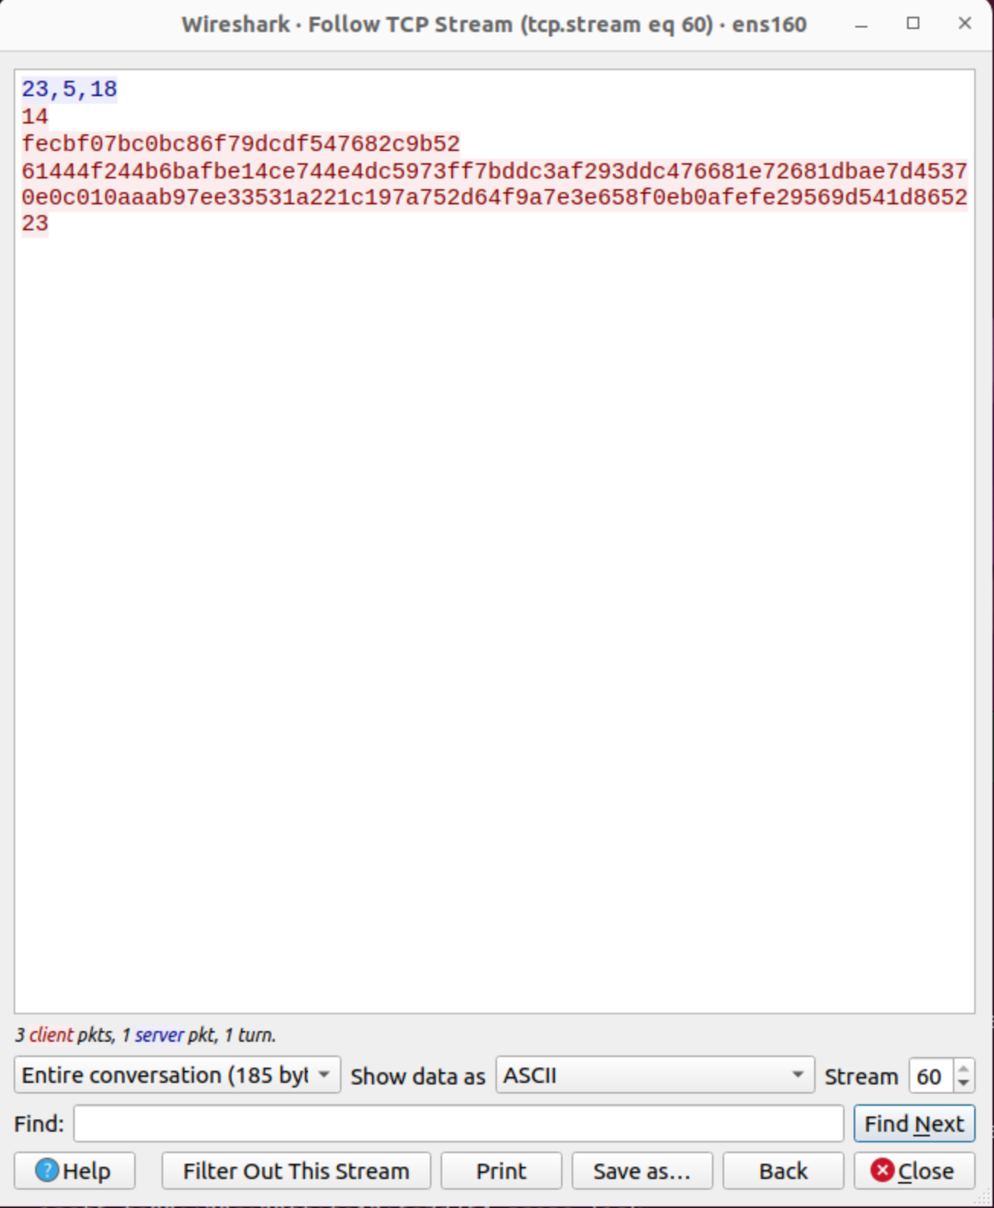
Wireshark Capture
MITM Wireshark capture

Slide 12
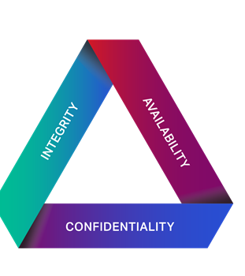
The three pillars of security
Currently Integrity and confidentiality are the two main pillars compromised with MITM and passive listening.

Slide 13

Step 4: Introducing a SHA-256
- Alice and Bob now need to prevent integrity issues, thus introducing SHA-256 to verify data integrity.

Slide 14
Hash script & verification
Before sending out a message, Alice creates a hash value to be sent with the message.
As Sebastian intercepts and tampers and recomputes the Hash it differs to what Bob expects to receive
Bob Verifies the hash value and sends back a signal that lets Alice know the message has been tampered with

Slide 15

Output

Slide 16
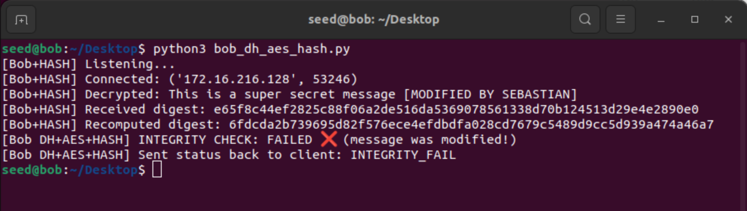
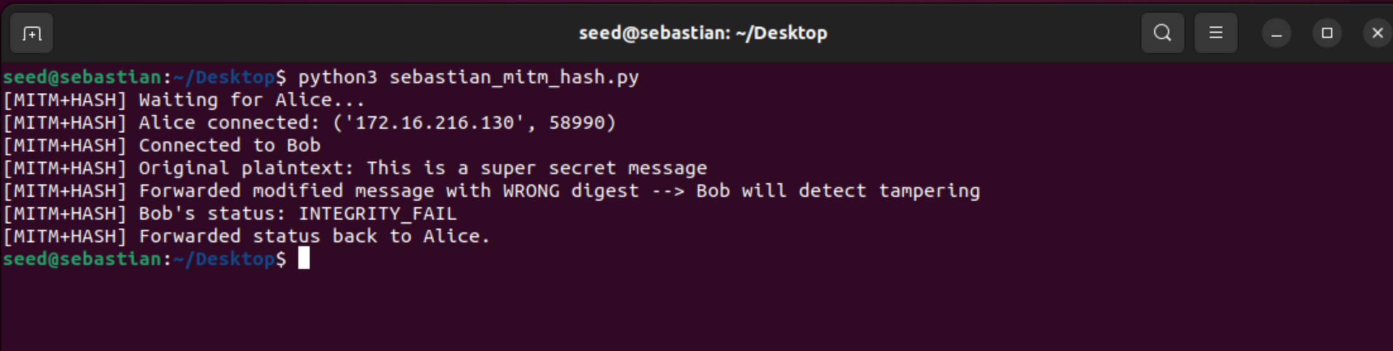
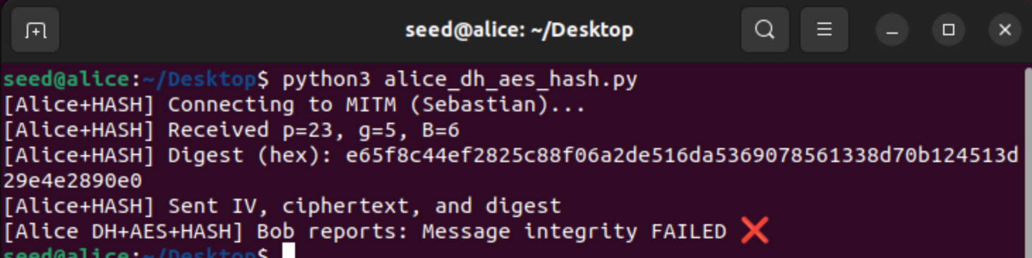
← BOB (Receiver)
Sebastian (Attacker) →
← Alice (Sender)

Slide 17
Summary
The purpose of this project is to demonstrate how data can be exploited in the network layer when it is not properly secured.
AES provided obscurity for the attacker
SHA-256 provided data integrity to catch tampering

